Slide 1
One degree of freedom: θ
Two degrees of freedom: θ₁ and θ₂

Slide 2
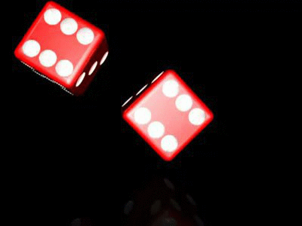
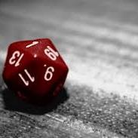
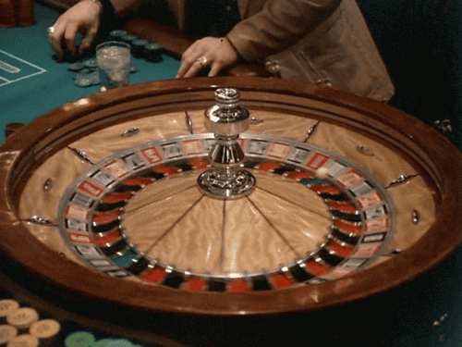

Unpredictable Systems

Slide 3

Probability and Statistics

Slide 4
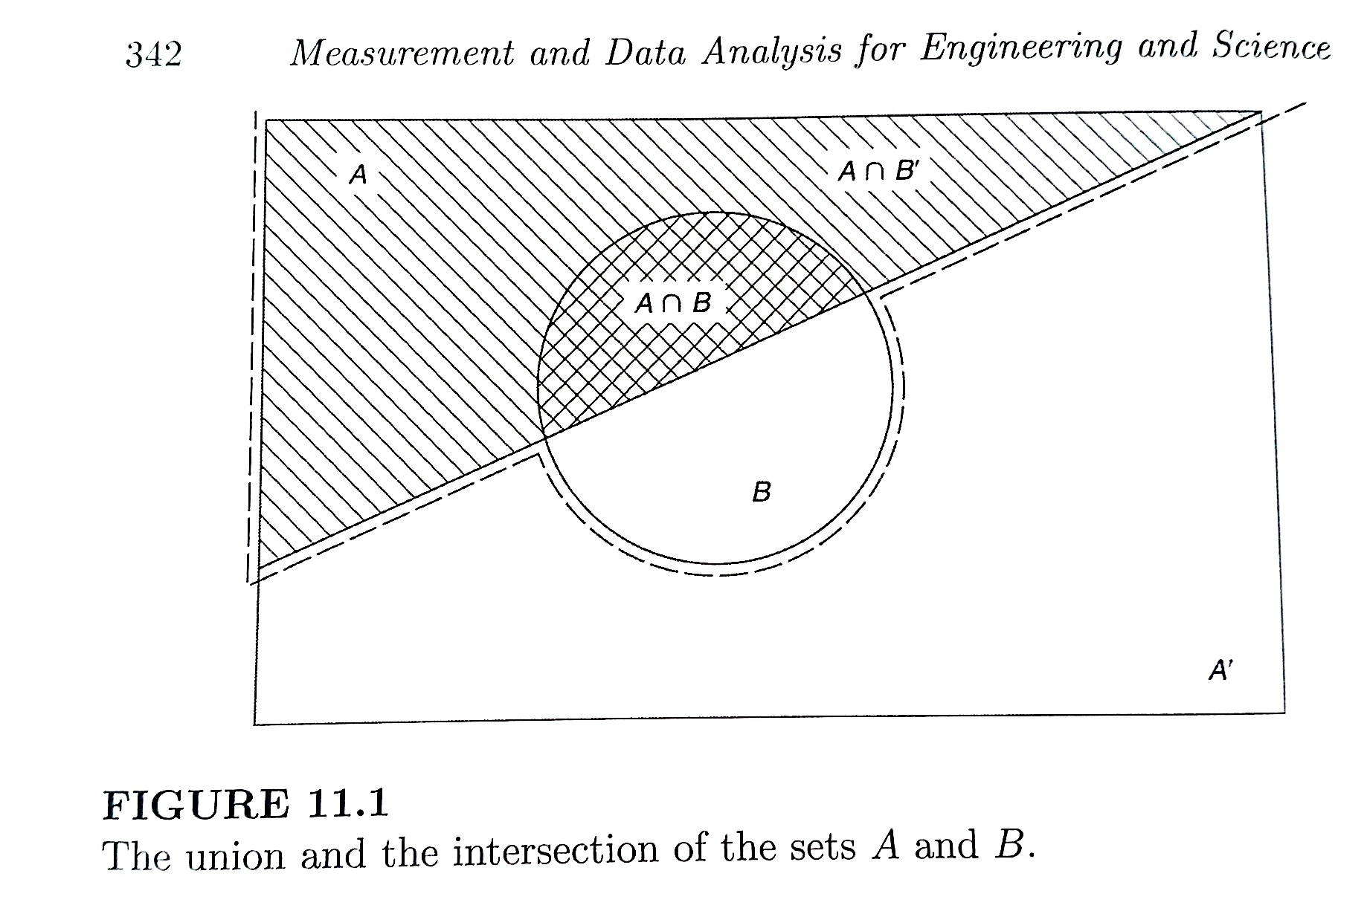
Probability – Venn Diagrams
Intersection “AND”
Union “OR”

Slide 5

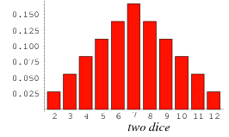
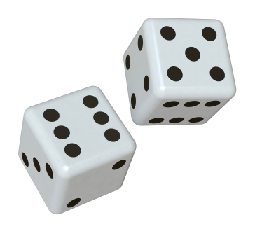
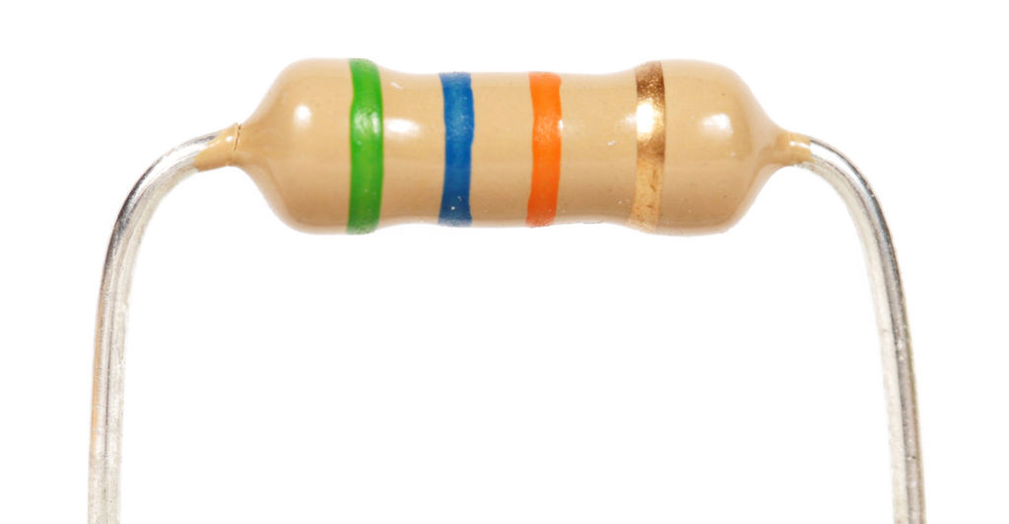
A12 – Monte Carlo Night!
Pair of Dice
Manufactured Resistors

Slide 6
Plinko Board
For a board with n rows of pegs,
prob. of landing in k^{th} bin:
k =
Prob. of going left or right: a = 0.5

Slide 7
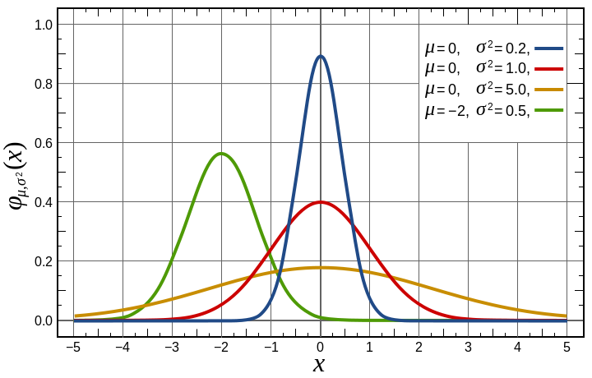
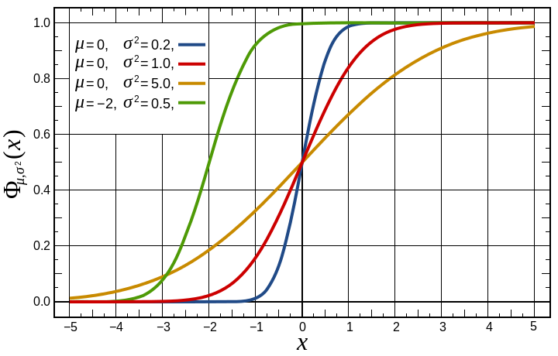
Gaussian Distribution
Central Limit Theorem – For large N, most distributions become Gaussian
Gaussian PDF
Gaussian CDF

